Slide 1
Introduction To Programming
How to talk with Computer Machine

Slide 2
How Programming Works
A computer is essentially just a big bunch of small electronic switches that are either on or off.
By setting different combinations of these switches, you can make the computer do something, for example, display something on the screen or make a sound.
That's what programming is at its most basic—telling a computer what to do.
Of course, understanding which combination of switches will make the computer do what you want would be a difficult task—that's where programming languages come in

Slide 3
What Is a Programming Language?
People express themselves using a language that has many words.
Computers use a simple language that consists of only 1s and 0s, with a 1 meaning "on" and a 0 meaning "off.“
Trying to talk to a computer in its own language would be like trying to talk to your friends by using Morse code—it can be done, but why would you?

Slide 4
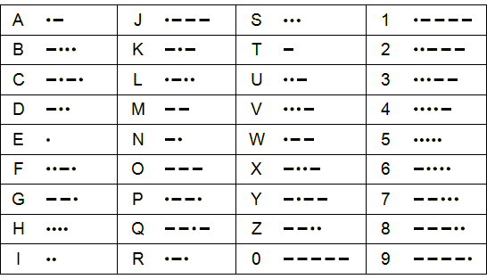
PL(Cont..) Morse Code

Slide 5
PL(Cont..)
A programming language acts as a translator between you and the computer.
Rather than learning the computer's native language (known as machine language), you can use a programming language to instruct the computer in a way that is easier to learn and understand.
A specialized program known as a compiler takes the instructions written in the programming language and converts them to machine language.

Slide 6
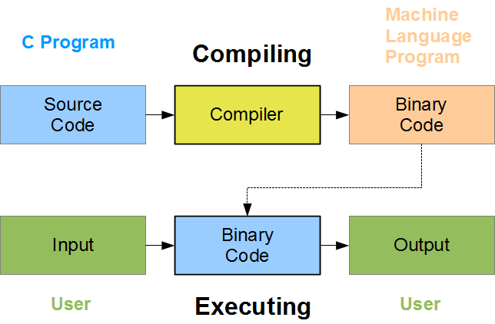
PL(Cont..)

Slide 7
PL(Cont..)
This means that as a C programmer, you don't have to understand what the computer is doing or how it does it.
You just have to understand how the “C programming language” works.

Slide 8
History of C Programming Language
C is a programming language which born at “AT & T’s Bell Laboratory” of USA in 1972.
C was written by Dennis Ritchie, that’s why he is also called as father of c programming language.
C language was created for a specific purpose i.e designing the UNIX operating system (which is currently base of many UNIX based OS).
From the beginning, C was intended to be useful to allow busy programmers to get things done because C is such a powerful, dominant and supple language.

Slide 9
History of C PL(Cont..)
Its use quickly spread beyond Bell Labs in the late 70’s because of its long list of strong features.
Assignment!!
List Features of C Programming Language.
May take from:
http://www.c4learn.com/c-programming/c-features/

Slide 10
Why Name “C” was given to Language ?
Many of C’s principles and ideas were derived from the earlier language B. (Ken Thompson was the developer of B Language.)
BCPL and CPL are the earlier ancestors of B Language.
CPL is common Programming Language.In 1967, BCPL Language ( Basic CPL ) was created as a scaled down version of CPL
As many of the features were derived from “B” Language thats why it was named as “C”.
After 7-8 years C++ came into existence which was first example of object oriented programming .

Slide 11
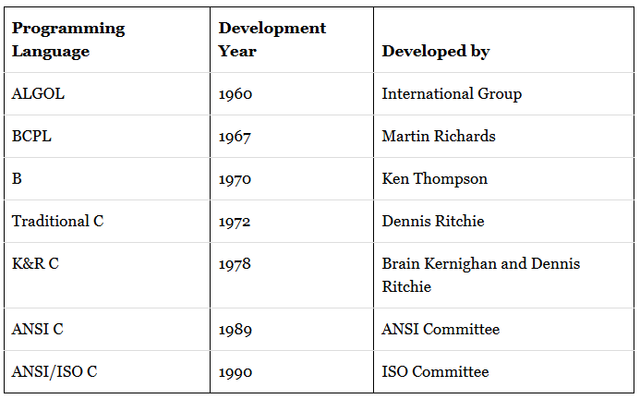
C Programming Language Timeline

